Slide 1
MODULE III
grep

Slide 2
grep stands for global regular expression print.
search the input file for all lines that match a specified regular expression and write them to standard output.
Search utility

Slide 3
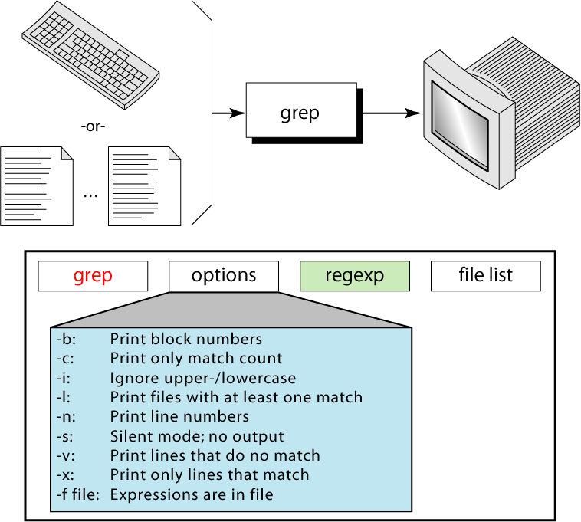

Slide 4
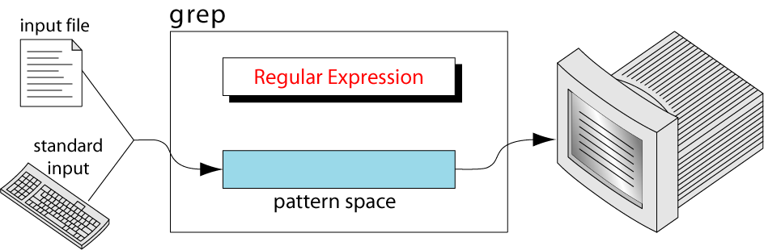
grep Operation
Copies the next input line into the pattern space.
Applies the regular expression to the pattern space.
If there is a match, the line is copied from the pattern space to the standard output.

Slide 5
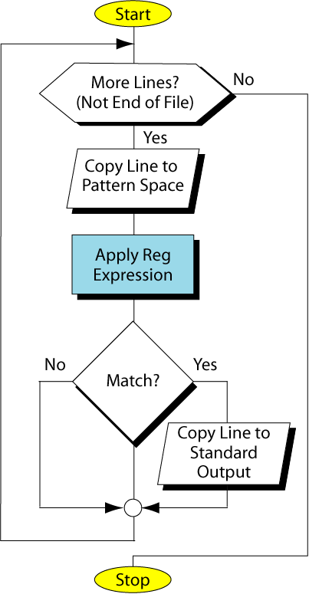
grep
Flowchart

Slide 6
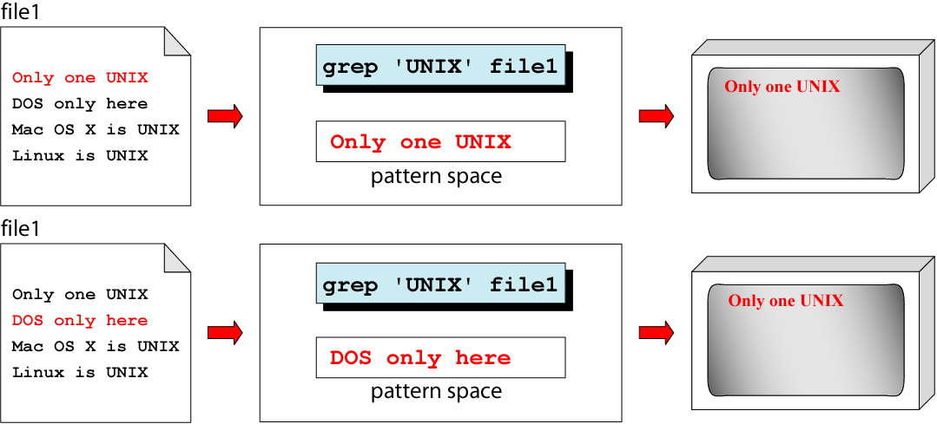
grep Example
Continued

Slide 7
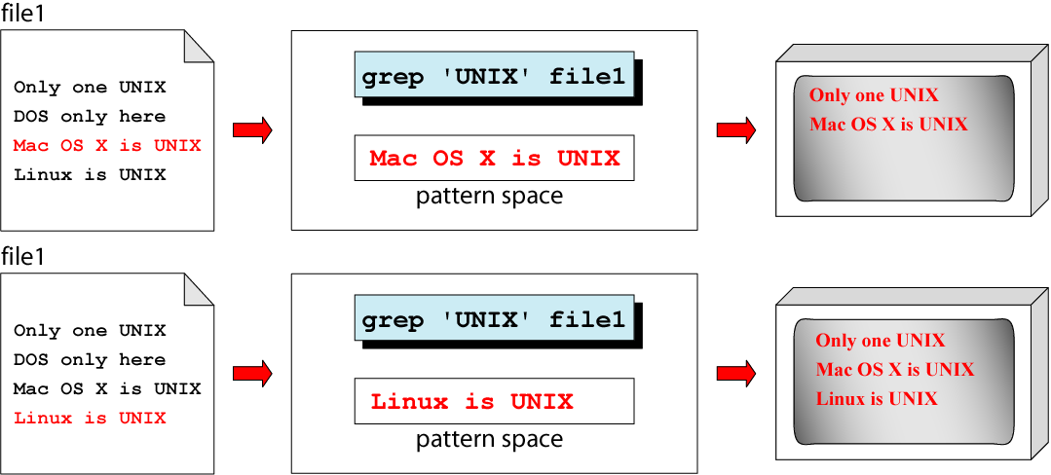
Example (cont)

Slide 8
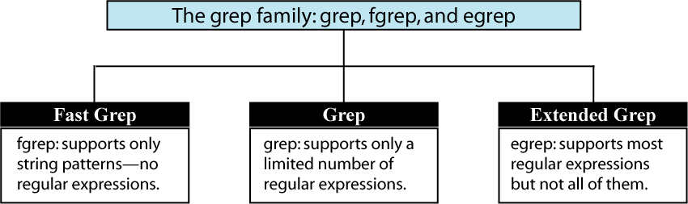
The grep Family
There are three utilities in the grep family

Slide 9
grep Family Options
-c prints only a count of the number of lines matching the pattern.
-i ignores upper-/lowercase in matching text
-l prints a list of files that contain at least one line matching the pattern.
-n show number of each line before the line.
-s silent mode
-v inverse output. Prints lines that do not match pattern
-x prints only lines that entirely match pattern
-f list of strings to be matched are in file

Slide 10
Examples
Select the lines that have exactly three characters
grep ‘^…$’ testfile
Select the lines from the file that have at least three characters
grep ‘…’ testfile
3. Select the lines from the file that have at least two digits without any character in between
grep ‘[0-9][0-9]’ testfile
4. Lines that start with any uppercase letter
grep “^[A-Z]” testfile

Slide 11
5. Select the lines from the file whose first nonblank character is A
egrep ‘^ *A’ testfile (or grep)
6. Select the lines from the file that do not start with A to G
grep ‘^[^A-G]’ testfile

Slide 12
Examples (cont)
7. Count the number of blank lines in the file
egrep –c ‘^$’ testfile
8. Count the number of nonblank lines in the file
egrep –c ‘.’ testfile
9. Select the lines from the file that have the string UNIX
fgrep ‘UNIX’ testfile

Slide 13
Examples (cont)
10. Select the lines from the file that have only the string UNIX
egrep ‘^UNIX$’ testfile
11. Select the lines from the file that have the pattern UNIX at least two times
egrep ‘UNIX.*UNIX’
12. Copy the file to the monitor, but delete the blank lines.
egrep –v ‘^$’ testfile

Slide 14
Examples (cont)
13. Select the lines from the file that have at least two digits without any character in between
egrep ‘[0-9][0-9]’ testfile
14. Select the lines from the file whose first nonblank character is A
egrep ‘^ *A’ testfile
15. Select the lines from the file that do not start with A to G
egrep –n ‘^[^A-G]’ testfile
16. Find out if John is currently logged into the system
who | grep ‘John’

Slide 15
egrep & fgrep
egrep :
  supports metacharacters in RE
  + ? * { } $ # etc
Qn: To find lines containing 5, followed by a literal period(.) or dot, & any single character
egrep “5\..” file1
possible answers :
5.a, 5.6, 5.0, 5.#

Slide 16
fgrep
Doesn’t recognize any RE
Supports only string patterns
Eg : fgrep “unix” file1
fgrep “[a-z][0-9]” file 1 will give an o/p only if file1 contains a string [a-z][0-9]

Slide 17
Options & eg.s of grep
Checking for a string in multiple files
grep “unix” file1 file2
file1 file2
o/p
file1: unix & shell
unix os
file2 : This is unix
unix & shell
unix os
This is unix
linux

Slide 18
2) Case insensitive (-i) or (-y)
Ignore case
grep –i “unix” file1 or grep –y “unix” file1 file1
o/p
unix
UNIX
UniX
unix & shell
UNIX os
UniX

Slide 19
3) Print the matched parts only (-o) ie only matching
[display the searched text only, from a line]
grep –o “unix” file1
o/p
unix
grep –io “unix” file1 (case insensitive)
o/p
unix
Unix
UNIX
unix & shell
Unix OS
UNIX

Slide 20
4) Lines that exactly matches the given string (-x)
[lines that contain the searched text alone]
grep “unix” file1 file1 grep –x “unix” file
o/p o/p
unix & shell unix
unix OS (3rd line only)
unix
unix & shell
unix OS
unix

Slide 21
5) Count the occurrence of searched string in the entire file
(-c)
grep –c “unix” file1 file1
o/p
1
grep –ci “unix” file1
3
unix & shell
Unix OS
UNIX

Slide 22
6) Check for full words, not for substrings (-w)
Eg: If we search for “is” , o/p may contain “this”,”his” etc
grep “is” file1 file1 grep –w “is” file1
o/p o/p
This is is
is is
What is is
This is
is
What is

Slide 23
7) To print the byte offset before each matched line (-b)
grep –b “unix” file1
file1
o/p
6: unix & shell
Linux
unix & shell

Slide 24
8) Print filename also for each match (-H)
grep –H “unix” file1
o/p file1
file1 : Linux & unix
file1 : unix
Linux & unix
unix

Slide 25
9) Print “n” lines after the matching lines (-A)
file1
grep –A NUM “RE” filename
grep –A 2 “unix” file1
[2 lines each after the matching lines]
o/p
Linux & unix
123
Asd
---
unix
456
Hai
Linux & unix
123
Asd
Ann
unix
456
Hai
Hello

Slide 26
10) Print n lines before the matching lines (-B)
grep –B 3 “unix” file1
o/p
Linux & unix
123
Asd
Ann
unix
[No lines before the first match, Linux & unix]
Linux & unix
123
Asd
Ann
unix
456
Hai
Hello

